Slide 1

miniPrint
„small effort, big results”

Slide 2




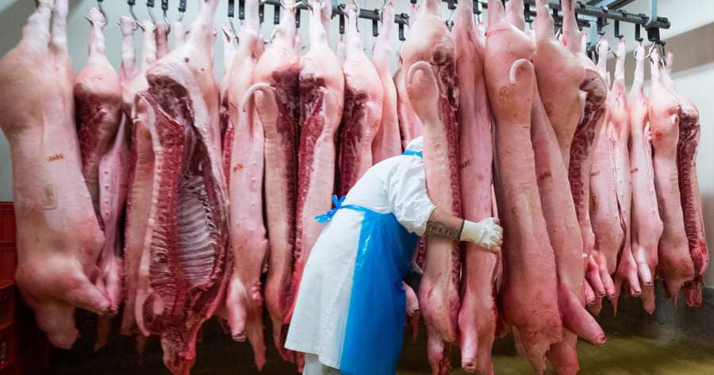
Problems Solutions
Enviroment pollution caused by modern lifestyle
Smog
Food waste
Water shortage
Adjustment of lifestyle
Social media format
Gamification to solve customer loyality

Slide 3




Competitors
Pawprint
EarthHero
Yayzy
klima

Slide 4
USP
Our application is a solution for reducing carbon footprints.
Our company values adjustment over change compared to other applications and we’re different in that we provide challenges over expecting results.
We connect different users from around the world with a better future in mind, who share the same concerns regarding the matter.

Slide 5
Social Impact strategy
Partnership rewards utilizing grocery stores (coupons), and other healthy and environmental options.
We have no expectations, we merely provide challenges and rewards.

Slide 6
Thank you! Made by:
Isza Csongor
Dósa Kleon
Huang Yu
Fábián Tímea Nikolett
Bathó Borbála
Kovács Márton

